Slide 1



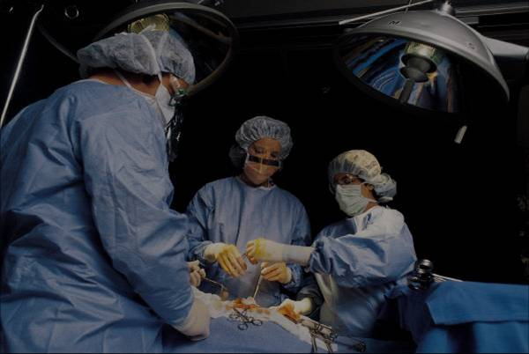

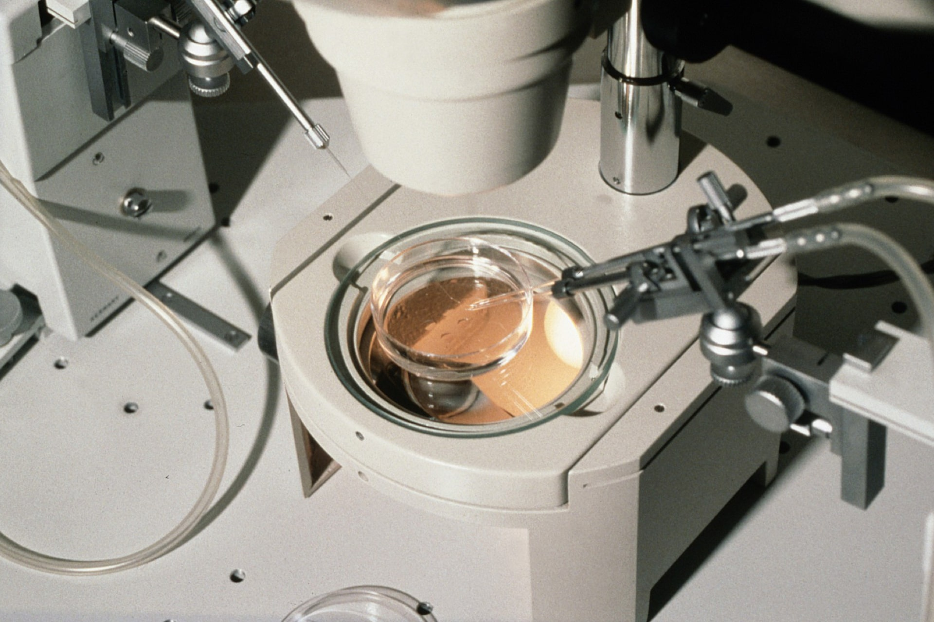
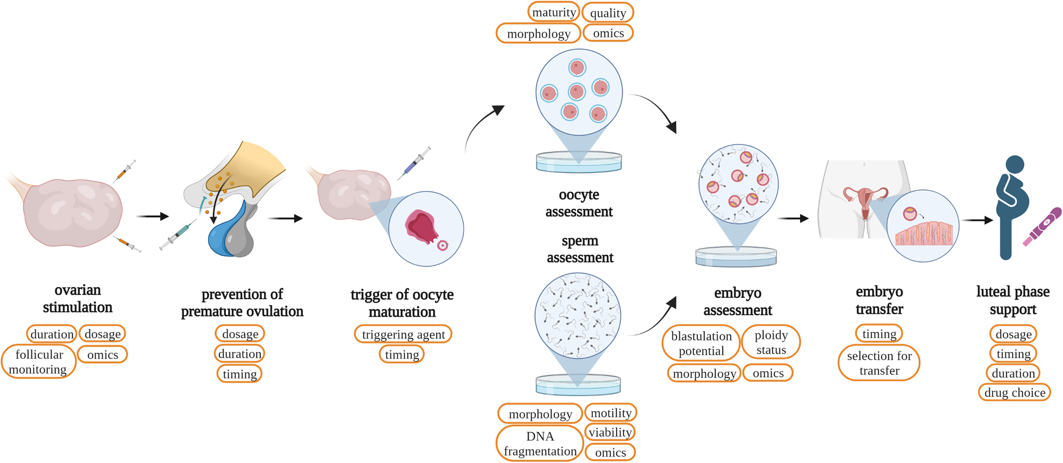
The Language of Reproductive Medicine:
Key Terminology
ABSTRACT
INTRODUCTION
RESULTS
TERMINOLOGY
Reproductive medicine is the branch of medicine that treats infertility. It helps couples in producing through use of IUI, IVF, and hormone therapy. The success rate has increased greatly in the last few years. Reproductive medicine also addresses related issues such genetic disorders and repeated miscarriage.
The specialty field of reproductive medicine aids in the management of infertility. It covers a range of techniques and treatments for issues related to infertility.
Reproductive medicine's primary goal is to comprehend the true reasons of infertility in both men and women. This entails a thorough assessment of various factors, including hormonal imbalances, anatomical abnormalities, genetic illnesses, and lifestyle decisions. Customized treatment plans can be developed to satisfy each patient's needs once the underlying causes have been identified.
Patients seeking healthcare self-care information regarding reproductive tract disorders should understand the roots of words employed in the delivery of such Information. When a person is more knowledgeable about health matters, they become in a position to select the therapy they require without someone else’s influence in case of such serious diseases such as polycystic ovarian syndrome (PCOS). This information makes the work easier and stimulates usage of more appropriate language in different specialties by doctors and students. It also educates people on the conditions pertaining to reproduction and assisted child bearing to enable the affected individuals advocate for their own well being. The understanding of these vocabularies enhances the extent of awareness people and the public have in improving the health standards as advocated by different groups and organizations about reproductive health difficulties; hence enhancing the management of reproductive health and fertility in the society or groups all together.
1 Menopause
Root: Men/o (month, menstruation)
Suffix: -pause (cessation)
2 Androgen
Root: Andr/o (male)
Suffix: -gen (producing)
3 Gynaecology
Root: Gynaec/o (woman)
Suffix: -logy (study of)
4 Orchitis
Root: Orchi- (testis)
Suffix: -itis (inflammation)
5 Oophorectomy
Root: Oophor/o (ovary)
Suffix: -ectomy (removal)
6 Cervicitis
Root: Cervic- (cervix)
Suffix: -itis (inflammation)
7 Laparoscopy
Root: Lapar/o (abdomen)
Suffix: -scopy (viewing)
8 Mastectomy
Root: Mast/o (breast)
Suffix: -ectomy (removal)
9 Colposcopy
Root: Clop/o (vagina)
Suffix: - scopy (viewing)
10Prostatitis
Root: Prostate/o (prostate gland)
Suffix: -itis (inflammation)
11 Amenorrhea
Prefix: A- (absence)
Root: Men/o (menstruation)
Suffix: - rrhea (flow)
12 Oogenesis
Root: O/o (egg)
Suffix: -genesis (formation)
13 Galactorrhoea
Root: Galact/o (milk)
Suffix: - rrhea (discharge)
14 Hysteroscopy
Root: Hyster/o (uterus)
Suffix: - scopy (viewing)
15 Anovulation
Prefix: An- (without)
Root: Ovul - (egg)
Suffix: - ation (process)
METHODS AND MATERIALS
Reproductive science researches and controls fertility through a number of apparatus and facilities. In general, intrauterine frozen fertilisation (IUI), and in vitro fertilisation (IVF) are used to freeze embryos and sperms (eggs).Ultrasound, hormonal assay, microscopy assist in the degree of embryo development as well as reproductive health management. Diagnostic and therapies of issues related to reproduction contain laparoscopy and genetic Diagnostic reagents encompass incubators with specialized instrumentation for sperm and egg extraction as well as culture media for embryos. Like ultrasound, hormonal assays, and microscopy help monitor the growth of the embryo and the state of the reproductive system. Diagnostic and therapeutic approaches for problems with reproduction include laparoscopy and genetic screening Laboratory supplies include things like incubators, specialised tools for removing sperm and eggs, and culture material for the development of embryos. These allow conception, help in identifying the reproductive problems, and being tools for fertility education.
.
.
REFERENCES
Centers for Disease Control and Prevention (CDC). (n.d.). "Reproductive Health." Retrieved from CDC.gov.
Speroff, L., & Fritz, M. A. (2011). Clinical Gynecologic Endocrinology and Infertility. Lippincott Williams & Wilkins.
Practice Committee of the American Society for Reproductive Medicine. (2015). "Definitions of infertility and recurrent pregnancy loss." Fertility and Sterility, 103(1), 50-57. doi:10.1016/j.fertnstert.2014.09.003.
CONTACT
NAME:ABDUL HAMEES SHAH
REGISTRATION:12317310
ROLL NO: 45

